Slide 1
EXCEL FINAL ASSESSMENT
4379
NITHIKKSHA S

Slide 2

1.Average Lead time between requested time and completed time
I have filled the blank value in work date by today’s date =today()
I have calculated the day difference using =days() function between requested date and completed date
Using average function, I have found the average time between requested time and completed time.

Slide 3
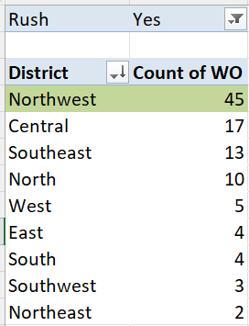
2.District that has a highest number of rush jobs

Slide 4
INFERENCE
North west district has the highest rush jobs with 45 work orders

Slide 5
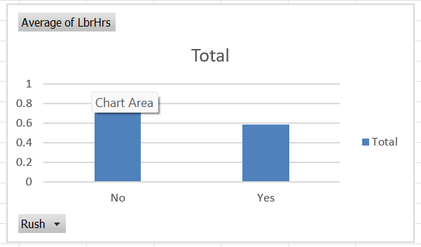

3. Average Lbrhrs difference between rush and non rush jobs

Slide 6
INFERENCE
The average working hours of non-rush jobs are higher compared to rush jobs.
Non rush jobs has an average of 0.79 lbrhrs and rush jobs has an average of 0.58 lbrhrs.
The average difference is calculated.

Slide 7
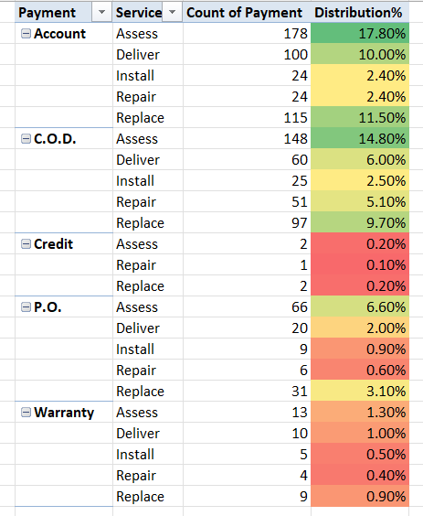
4. Distribution of payment types across different services

Slide 8
INFERENCE
Distribution across services for each payment is diplayed.
Account has higher distribution compared to all other payment method across each services, which is followed by COD , PO, Warranty and Credit.

Slide 9
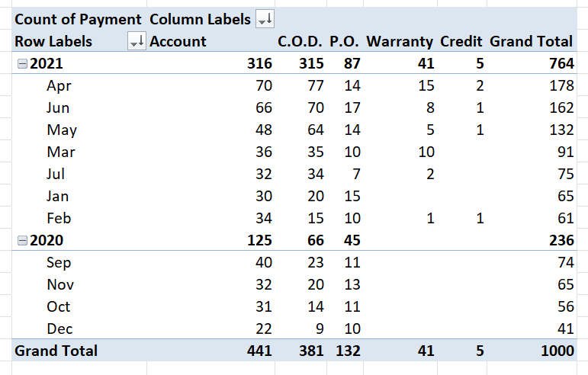
5.Trends in distribution

Slide 11
INFERENCE
Compared to 2020, 2021 has more orders overall
COD is always remains high and increases over time.
Account payment is standard
Warranty increases over time in less counts
Credit also has minor increase over time.

Slide 12
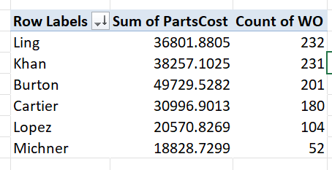
6.Relationship between technician and parts cost

Slide 14
Yes, there is relationship between technicians and parts costs.
As technicians increases the sum of parts costs also increases

Slide 15
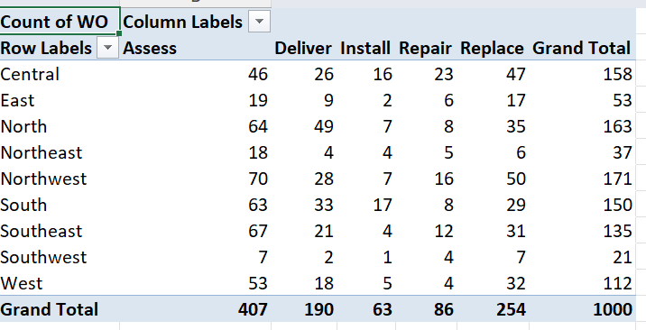
7. Most common type of services in each district
Assess is the most common type of services in each district

Slide 16
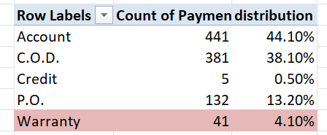
8.

Slide 17
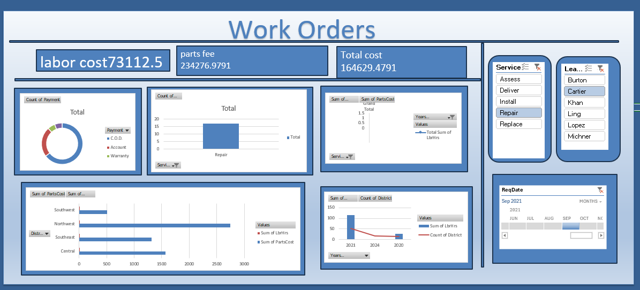
9.DASHBOARD

